Slide 1


Public Meeting
May 17, 2019
9:30 AM – 12:30 PM

Slide 2
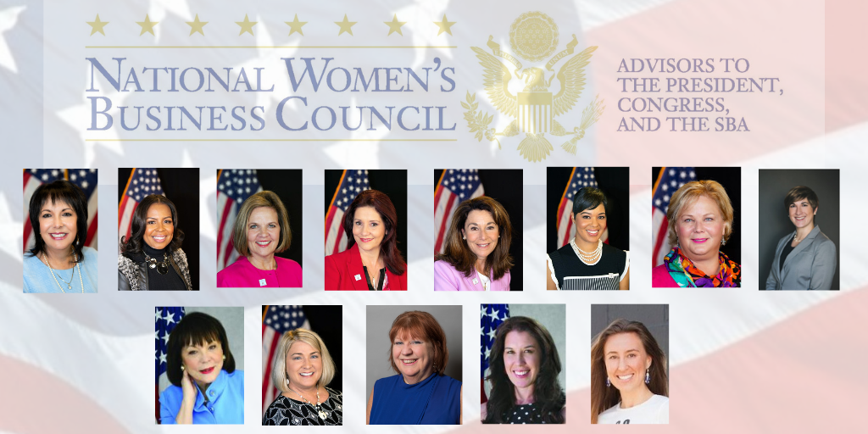
Roll Call

Slide 3
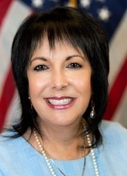
Opening Remarks
Liz Sara
Chair, National Women’s Business Council

Slide 4
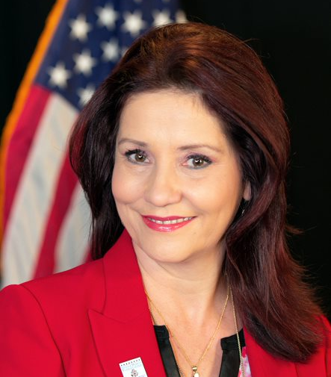
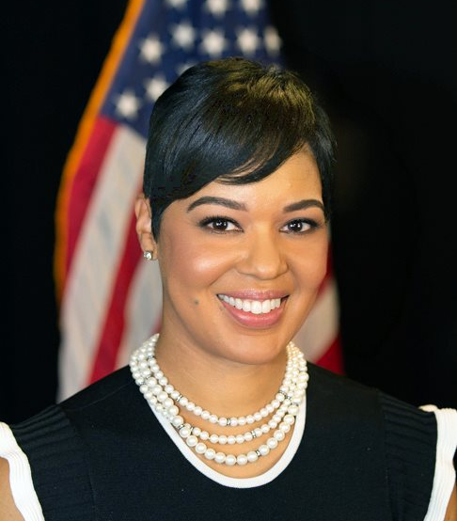
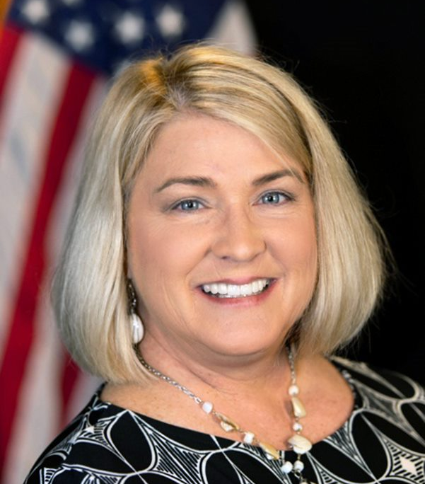

Access to Capital & Opportunity
Subcommittee Chair – Rebecca Contreras
Subcommittee members
  Nicole Cober
  Pamela Prince-Eason
  Vanessa Dawson

Slide 5
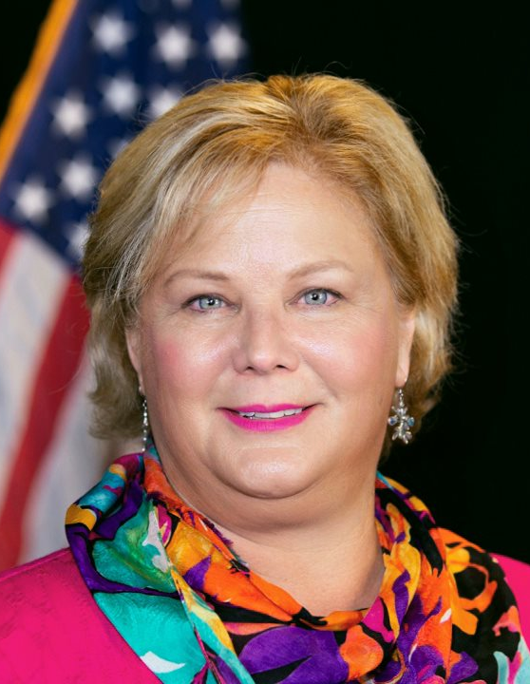
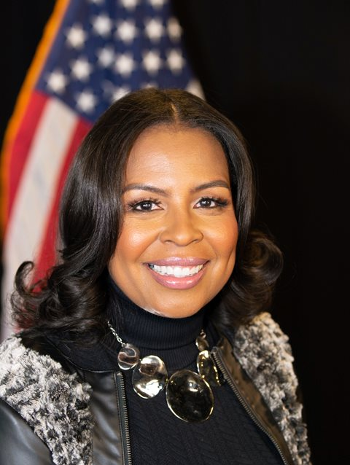
Women in STEM
Subcommittee chair
Shelonda Stokes
Subcommittee Member
Monica Stynchula

Slide 6
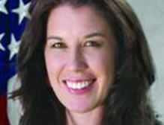
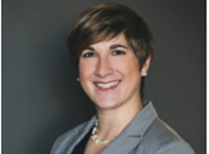
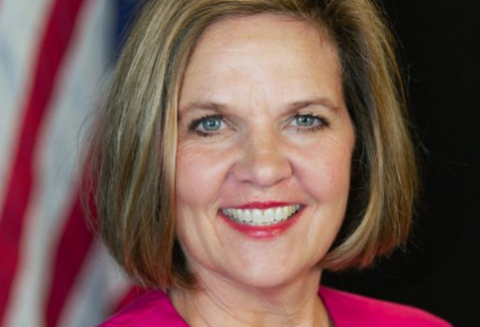
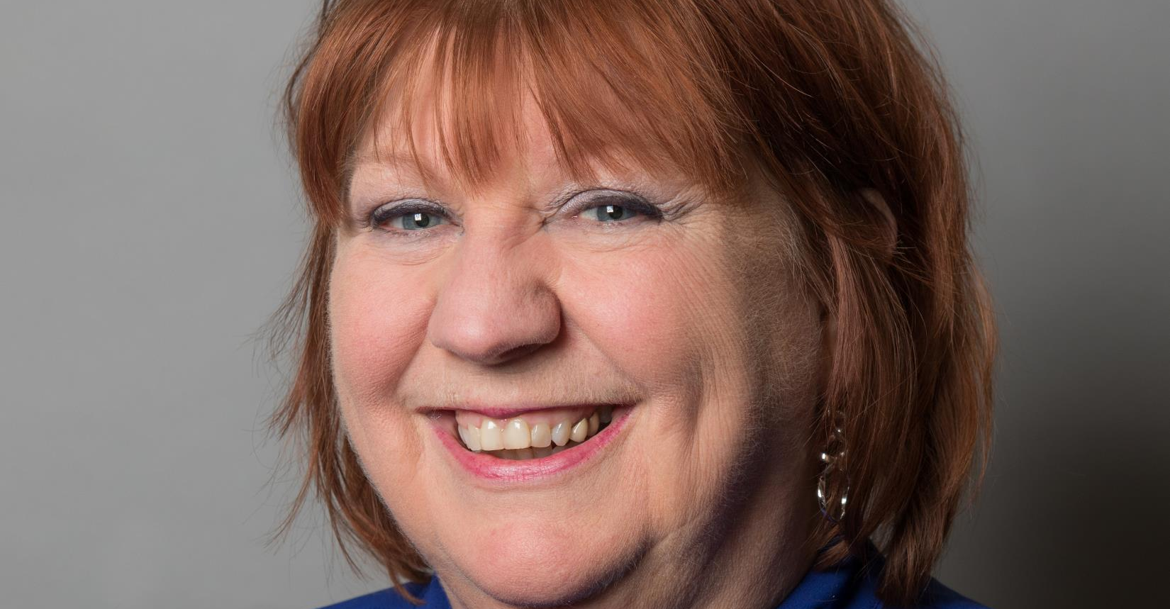
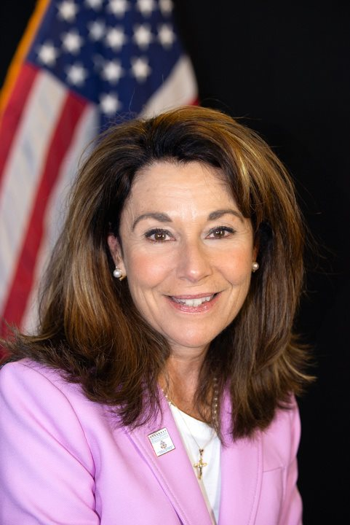
Rural Entrepreneurship
Subcommittee Chair – Marygrace Sexton
Subcommittee Members
  Jen Earle
  Jessica Flynn
  Barbara Kniff-McCulla
  Bonnie Nawara

Slide 7

Rural Women Entrepreneurs:
Challenges & Opportunities
Emma Broming, Premier Quantitative Consulting, Inc.

Slide 8
Rural Women Entrepreneurs: Challenges and Opportunities
Task A Research Highlights
National Women’s Business Council
Contract 73351018P0066
May 17, 2019

Slide 9
Why Rural Women?
Entrepreneurship is central to rural job creation and economic growth
  Source of two-thirds of new rural jobs
Challenges associated with rurality
  Decreased access to capital
  Lower availability of business support services
  Decreased access to skilled workforce
  Unreliable access to technology and broadband
  Lack of necessary infrastructure

Slide 10
Why Rural Women?
Gender differences exist among entrepreneurs in general
  Lack of women-focused research on rural entrepreneurship
Rural women are a unique segment of the U.S. population
  Educational disparities
  Differences in regional cultural norms
  Early marriage and child rates
  High incidence of poverty in rural areas

Slide 11
Research Goals
Inform and establish a baseline understanding of rural women entrepreneurial dynamics
Develop descriptive analysis that leads to areas for further inquiry and policy examination
Begin a dialogue related to the potential of and challenges facing rural women entrepreneurs

Slide 12
Defining Rural
State Rurality
Classifies entrepreneurs based on the percentage of each state’s population living in rural areas
Area Population Size
Splits entrepreneurs into eight categories based on the size of the population in the area ranging from non-metropolitan to a population of 5 million or more
Urban/Suburban/Rural
Splits entrepreneurs into three categories where urban refers to central city, suburban refers to respondents in a metropolitan area (but not central city), and rural refers to respondents in a non-metropolitan area
Rural vs. Non-Rural
Splits entrepreneurs into two categories based on living within or outside a metropolitan statistical area (MSA)
Notes:
State Rurality
Examination of the effect of residing in a largely rural state compared to a rural area in a state with larger urban areas
For example, an entrepreneur in an urban area in a very rural state may face different challenges or opportunities than an entrepreneur in an urban area in a more urban state

Slide 13
Data and Research Approach
American Community Survey (ACS) and Current Population Survey (CPS)
  Reliable, nationally-representative
Descriptive Analysis
  Distributions
  Cross-tabulations
  Difference in means testing
  Conditional analysis
  Each analysis utilizes one definition of rural

Slide 14
Marital Status and Children
Notes:
Entrepreneurs are more likely to be married than non-entrepreneurs
The highest rate of marriage among women entrepreneurs is in rural areas, followed closely by suburban areas.
Entrepreneurs are more likely to have children and women entrepreneurs are more likely than men
Past work demonstrates the balancing act that women face, including balancing their business responsibilities with their family commitments, and the role of entrepreneurship in alleviating this balance

Slide 15
Industry and Occupation
Notes:
Entrepreneurs are more likely to be married than non-entrepreneurs
The highest rate of marriage among women entrepreneurs is in rural areas, followed closely by suburban areas.
Entrepreneurs are more likely to have children and women entrepreneurs are more likely than men
Past work demonstrates the balancing act that women face, including balancing their business responsibilities with their family commitments, and the role of entrepreneurship in alleviating this balance

Slide 16
Industry and Occupation
Notes:
Entrepreneurs are more likely to be married than non-entrepreneurs
The highest rate of marriage among women entrepreneurs is in rural areas, followed closely by suburban areas.
Entrepreneurs are more likely to have children and women entrepreneurs are more likely than men
Past work demonstrates the balancing act that women face, including balancing their business responsibilities with their family commitments, and the role of entrepreneurship in alleviating this balance

Slide 17
Poverty and Income
Entrepreneurs
Notes:
Women entrepreneurs in rural areas are less likely to be classified as low income than women non-entrepreneurs in rural areas
Women entrepreneurs without children earn more than women entrepreneurs with children. The opposite is true for men.
In rural areas, women entrepreneurs with children earn approximately 25 percent less than women entrepreneurs without children

Slide 18
Usage and Qualification for SNAP
Note: SNAP data are underreported within the CPS. The SNAP income eligibility analysis is included to control for non-reporting bias.
Notes:
Examination of the prevalence of SNAP usage and income eligibility for women by rurality
Across geographies, women entrepreneurs are much less likely than non-entrepreneurs to report or qualify for SNAP assistance
The gap is largest in more rural areas

Slide 19
Internet Access and Usage
Entrepreneurs
Women Entrepreneurs
Notes:
Women entrepreneurs are more likely to have internet access than men, across rurality
Why don’t some rural women entrepreneurs have internet?
Rural areas are the only region where “not available in area” was selected
The majority of rural women entrepreneurs without internet do not want it
Raises important questions about adoption of technology among rural entrepreneurs and the related economic impact

Slide 20
Thank You

Slide 21
Rural Entrepreneurship
Subcommittee Chair – Marygrace Sexton
Subcommittee Members
  Jen Earle
  Jessica Flynn
  Barbara Kniff-McCulla
  Bonnie Nawara

Slide 22

Congressional Affairs Update

Slide 23
Public Comment & Questions

Slide 24
Thank You

