Slide 1




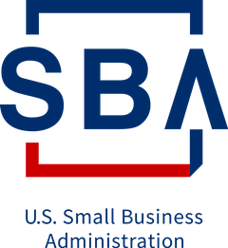

with
#WebinarWednesday
and
Wednesday, July 22, 2020 | 1:00 PM EDT
EMERGING OPPORTUNITIES IN TRADE
FOR
WOMEN ENTREPRENEURS
Learn about opportunities in exporting, digital trade and programs that are supporting women entrepreneurs.

Slide 2
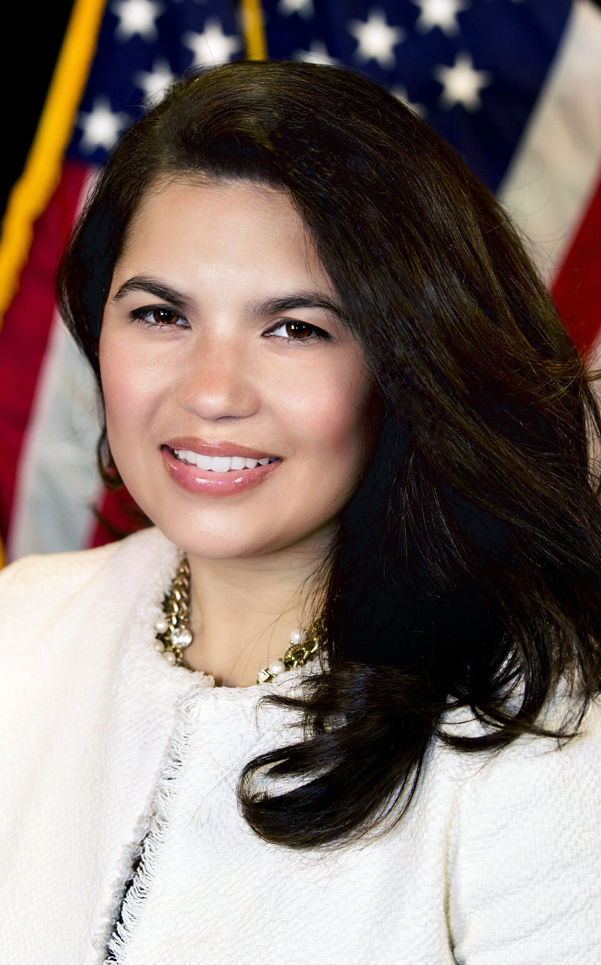
NINA ROQUE
Executive Director,
National Women's Business Council
National Women's Business Counil
#WEBINARWEDNESDAY

Slide 3
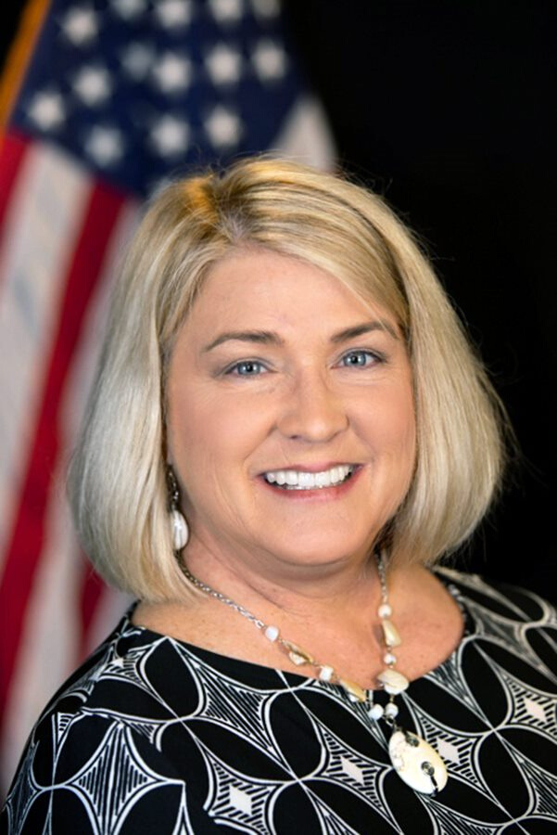
PAMELA
PRINCE-EASON
Council Member,
National Women's Business Council
National Women's Business Council
#WEBINARWEDNESDAY

Slide 4
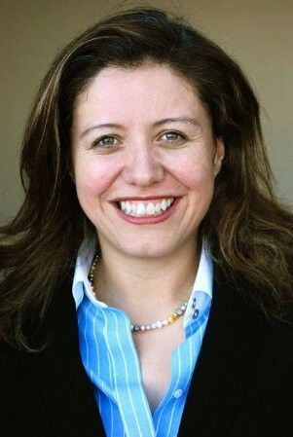
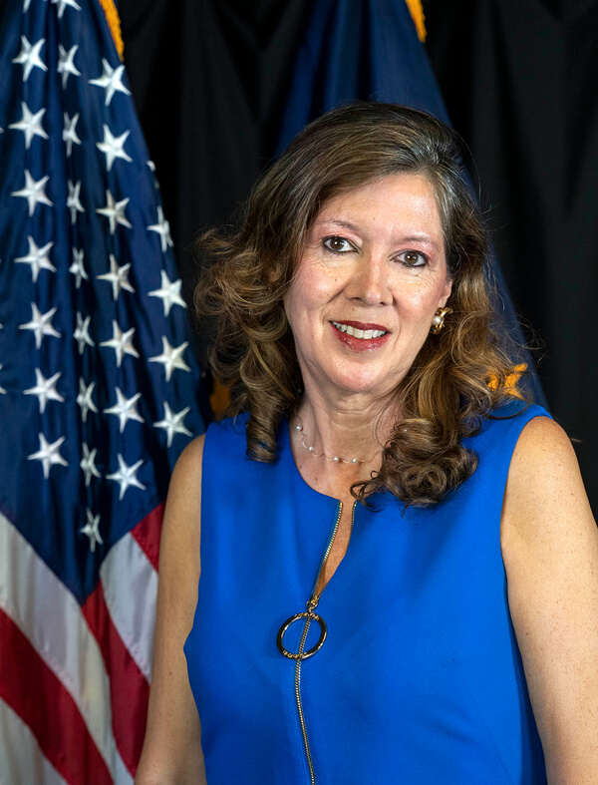
DISCUSSION
MARIA LUISA BOYCE
LORETTA GREENE
Vice President of Global Public Affairs, UPS
Associate Administrator for the Office of International Trade (OIT), SBA

Slide 5



Grants to Reach International Buyers
The State Trade Expansion Program or STEP provides grants to U.S. states/territories to help small businesses to go international.
Your small businesses may qualify for a grant and/or training to:
Pay website fees to sell overseas
Translate websites into foreign languages
Search engine optimization
Localize/internationalize your website specific to your overseas market
Design marketing media, including digital marketing media
Participate in virtual trade missions
Obtain market research and initial market check to determine opportunities
Attend training workshops (e.g. ExporTech)
Visit sba.gov/international to find out if your state/territory is participating in SBA’s State Trade Expansion Program.
Notes:
I also want to let you know about the State Trade Expansion Program.
I hope you are all familiar with STEP. It has been an incredible resource for U.S. small business exporters. Our goal with the STEP is to help all small businesses meet their international goals.
Find new markets
Expanding sales in current markets
Last year, STEP helped over 6,000 businesses with $18 million in grants to 44 States/territories. These businesses, in turn, reported over $500 million in export sales.
Each State/Territory runs the program slightly differently, so visit sba.gov/international to find out if your state or territory participates.
To achieve this, STEP offers grants to help your business:
Learn how to export through paid training fees
Participate in foreign and virtual trade missions and trade shows
Obtain services to support foreign market entry
International Partner Search Plus Virtual Introductions for business matchmaking
Translate websites to attract foreign buyers
Conduct Market intelligence reports and initial market check
Design international marketing products or campaigns.
And I am really pleased to let you know that the next round of STEP grants has increased to $19 million.
So if you are interested in finding out if your state has a STEP grant that can support global sales, visit sba.gov/international.
I want to turn the presentation over now to David Vidal, SBA’s Head of International Trade Finance to talk a little more about our SBA export finance programs.
Add something on patent & trademark fees

Slide 6
Finance Your
International Sales
Loan options for direct and indirect exporters (AKA supply chain):
Export Express for business development
  $500,000 limit
Export Working Capital to fulfill your international & supply chain orders
  $5 million limit
International Trade Loan for expanding your production capacity, re-financing debt, and reshoring
  $5 million limit
Email international@sba.gov with your contact information and
trade questions
Notes:
KEY TAKEAWAY MESSAGE: Get Financing for International Sales with SBA Loan Guarantees
SBA partners with lenders to offer three different export loan products – these loan products address a range of business financing needs
Not only for direct - but also for indirect exporters –
Indirect exporters are - those businesses who sell to other US businesses that then export their products. – Think supply chain.
SBA’s 3 export loan products are helping businesses achieve roughly $2.3 billion in sales per year.
The SBA’s Export Express Loan program allows access to capital quickly for businesses that need financing up to $500,000. You can apply for a line of credit prior to final-i-zing an export sale or even before visiting a foreign market. Getting your financing lined up ensures that adequate financing is in place before you agree to contract terms.
Small Business Exporters can use the Export Working Capital Program to fulfill export orders and finance international sales by providing revolving lines of credit of up to $5 million.
The International Trade Loan program can help if your company has been affected by foreign competition and needs to retool or expand to better compete. It can also help exporting firms seeking to expand international sales.

Slide 7


Emerging Opportunities for Women Entrepreneurs in Trade
Women Exporters Program

Slide 8
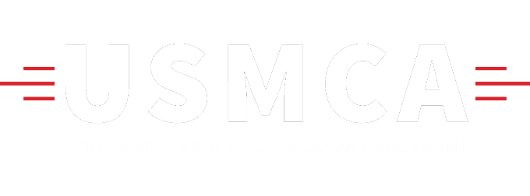



New Opportunities
Canada has raised its de minimis level + will provide for duty free shipments up to $C150.
Market access without a foreign office or foreign representative.
Market Access
For US SMBs
De Minimis
Improvement
New information resource from SBA OIT + Dialogue to address SMB opportunities & challenges.
New provisions increase protection for firms in the U.S. who rely on intellectual property.
Resource Site
+ SME Dialogue
Intellectual Property
Notes:
Market Access for US SMBs - U.S. small business services can now be provided market access across North America without requirements for a foreign office or foreign representative.
Resource Website + SME Dialogue - SBA OIT launched a new international sales information resource site to help SMBs. The SME Dialogue considers small business trade opportunities and challenges across the three countries.
De Minimis Improvement - Canada has raised its de minimis level for North American express shipments to $C40 for taxes. Canada will also provide for duty free shipments up to $C150.
Intellectual Property - The new intellectual property rights provisions will increase protection for firms in the U.S. who rely on intellectual property.

Slide 9
Economic Impact
    SMBs employ broad segments of the labor force, including low-skilled workers, and providing opportunities for skills development.
SMBs account for much of the world’s formal employment
52%
34%
in emerging
economies
in developing
economies
⅓
SMBs generate
one-third of GDP in developing and emerging economies.
Information sourced from the OECD Key Issues Paper on Strengthening SMEs and entrepreneurship for productivity and inclusive growth
Notes:
SMBs create job opportunities across geographic areas & sectors.
A conducive business environment, including institutional and regulatory settings established by FTAs like the USMCA, fosters this growth potential.

Slide 10
We know that investing in women-owned businesses is not only the right thing to do — it’s the smart thing to do.
Strategic Partnerships
ITC SheTrades Initiative, the U.S. Government, Chambers of Commerce, government export promotion entities around the globe, academia, international development agencies, and NGOs.
This presentation may not be used or disclosed to other than employees or customers, unless expressly authorized by UPS.
© 2020 United Parcel Service of America, Inc. UPS, the UPS brandmark, the color brown are trademarks of United Parcel Service of America, Inc. All rights reserved.
Notes:
MLB

Slide 11



Central Objectives
Capacity building
Training sessions focus on global trade and brokerage basics, as well as specific customs guidelines for the country in which the workshop is hosted and its primary trade partners.
Market Access
Through NGO and government partnerships, UPS assists businesses in identifying market access opportunities and tapping into high-demand industries that suit their skills and circumstances.
Regulatory Framework
UPS leverages academic studies and policy discussions to advocate for dismantling policy barriers to women who want to export, fostering a regulatory environment that enables greater export growth by women-owned businesses.

Slide 12

What was accomplished in 2019?
31 events in eight countries, directly trained over 2,730 women entrepreneurs.
Pilot program with more than 80 WOBs in Nigeria coaching the companies through their first six months of international trade
“Growth Accelerator for Women-Owned Businesses,” a mentorship program for women business owners in Dubai.
5-year MOU with USAID under the Women Global Development Prosperity Initiative (W-GDP)
Plurilateral initiative that promotes women’s ability to engage in trade under the auspices WTO

Slide 13
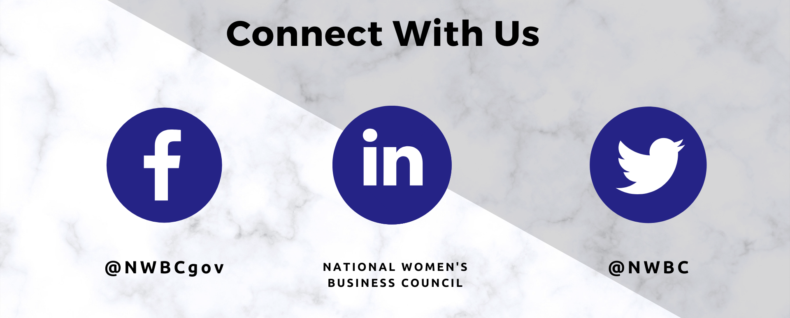
THANK YOU

