Slide 1
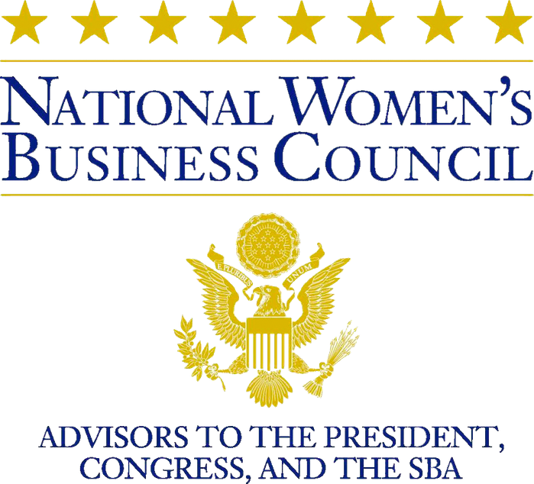
#WebinarWednesday

Slide 2
#WebinarWednesday
Financing Your Future
Leveraging Federal Resources to Eliminate Disparities & Build Wealth
NATIONAL WOMEN'S BUSINESS COUNCIL | JUNE 17, 2020

Slide 3
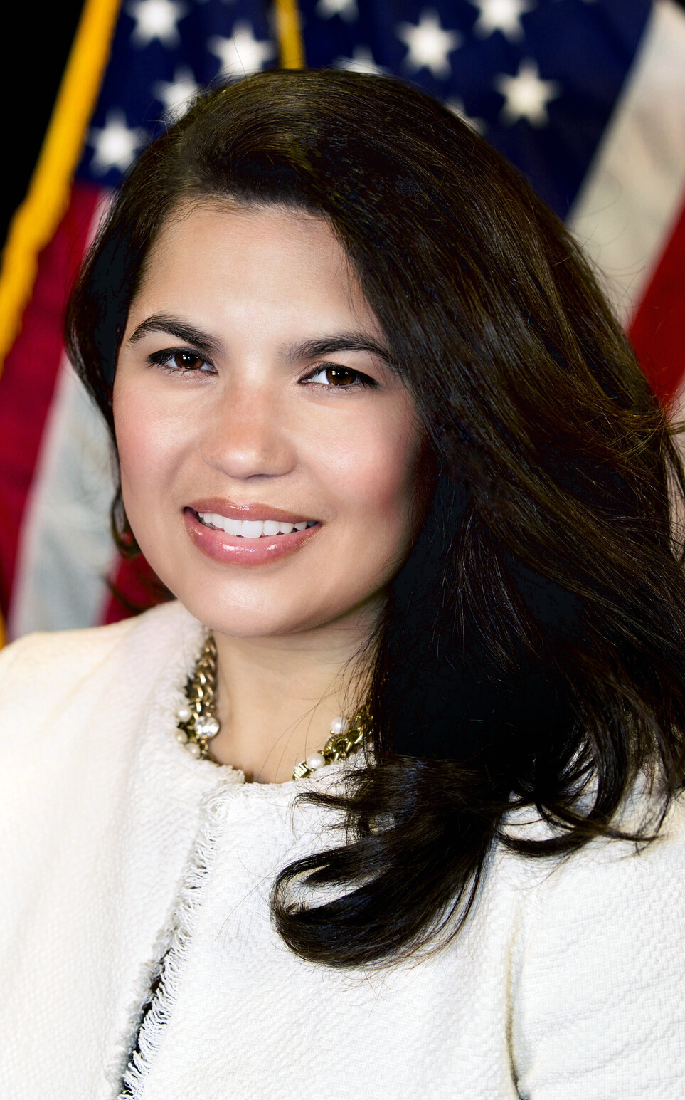
Executive Director, National Women's Business Council
Nina Roque

Slide 4
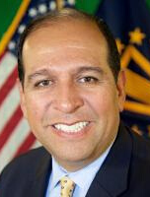
Associate Administrator of the Office of Entrepreneurial Development, U.S. Small Business Administration
Allen Gutierrez

Slide 5
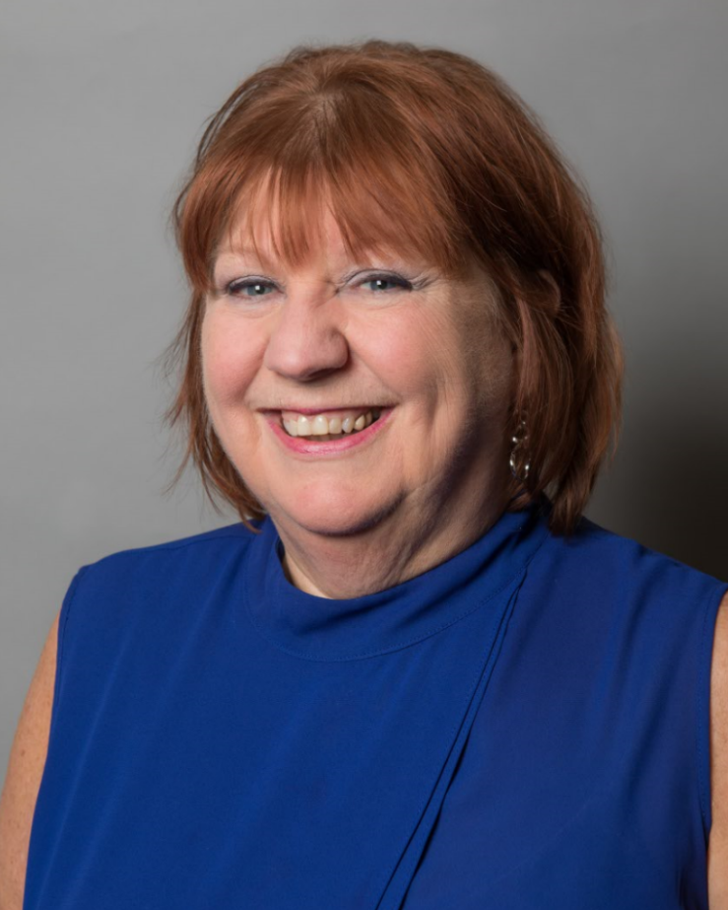
Council Member, National Women's Business Council
Bonnie Nawara

Slide 6
Federal Resources For Small Businesses
http://covid-sb.org/
#WebinarWednesday | JUNE 17, 2020

Slide 7
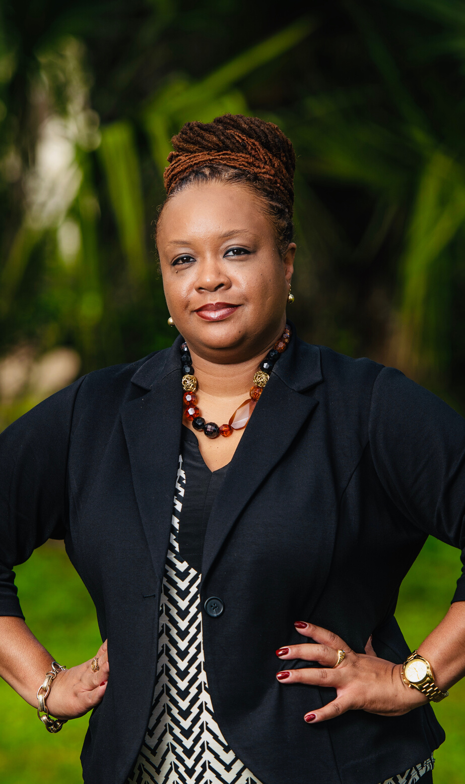
Vice President
Center for Entrepreneurship & Innovation (CEI) at the Urban League of Louisiana based in New Orleans, LA.
Klassi Duncan

Slide 8
Klassi Duncan
Klassi R. Duncan currently serves as Vice President of the Center for Entrepreneurship & Innovation (CEI) at the Urban League of Louisiana based in New Orleans, LA. CEI operations include two centers: the Women’s Business Resource Center, and the Contractor’s Resource Center. The CEI provides small business education, counseling services, and access to resources to women and minority entrepreneurs across Southeast Louisiana. In this role, Klassi is responsible for the oversight and management of the organization’s operations, programming, and staff. Her responsibilities include establishing and leading the strategic direction of the organization, developing market-specific training curricula and special events, fund development and management, fostering strategic partnerships, and increasing the Centers’ impact in the community.
Under her leadership, the Women’s Business Resource Center was awarded the 2019 Region VI Women’s Center of Excellence Award and the 2017 Women’s Business Champion Award by the U.S. Small Business Administration, Louisiana District Office for their work in promoting and developing women-owned businesses across the region.

Slide 9
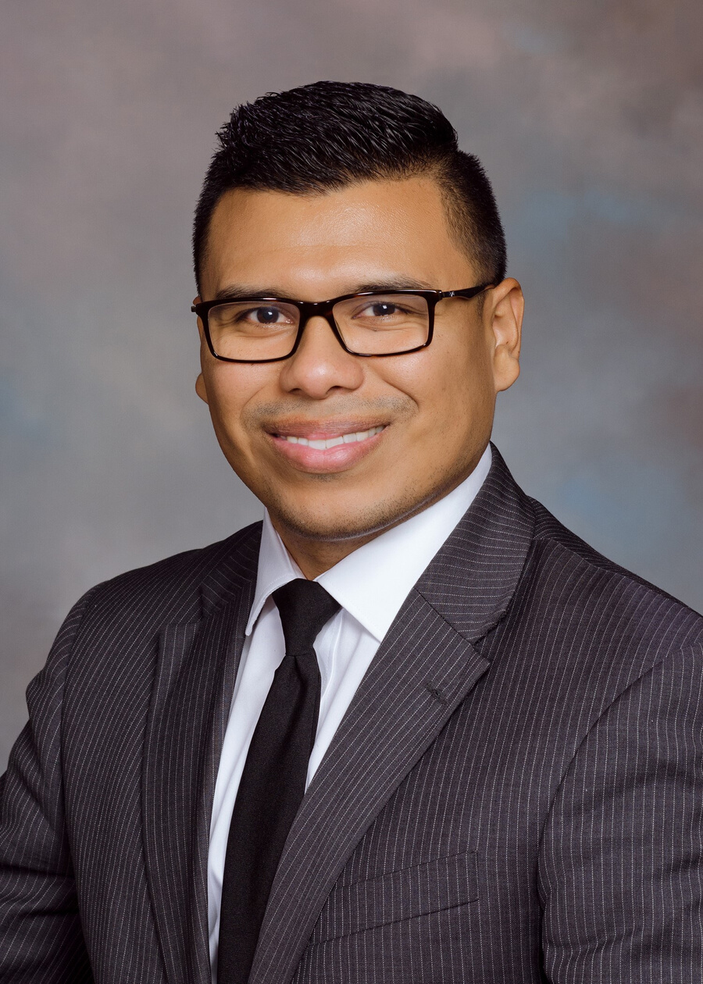
Community Affairs Specialist
Outreach and Program Development
Division of Depositor and Consumer Protection
Federal Deposit Insurance Corporation (FDIC)
David Ramos

Slide 10
David Ramos
David is responsible for Spanish language financial education curriculum and capabilities strategies within
the office of Outreach and Program Development. He is the national manager of the Money Smart for Small Business financial education training curriculum and serves as the division’s FinTech strategist who helps understand new technologies which seek to expand banking services to the unbanked, underbanked, and individuals in underserved communities.
David joined the Federal Deposit Insurance Corporation (FDIC), with fifteen years of banking experience serving in various retail, commercial and community development roles in the banking industry. He most recently served as Vice President and Regional Multicultural Banking Director for BB&T Bank overseeing multicultural banking operations for five of the corporation’s Mid-Atlantic regions.
Further, he is currently serving a four-year gubernatorial appointment to the Board of Commissioners of the Virginia Housing Development Authority (VHDA) where he is responsible for providing direction to the governance and policy implementation of the Authority. His professional background consists of experience in retail branch management, small business credit underwriting, commercial lending, portfolio management, community development lending, affordable housing policy and corporate and public relations.

Slide 11
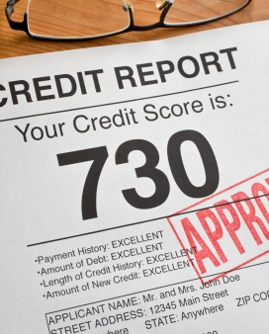
Financing your Future:
NATIONAL WOMEN'S BUSINESS COUNCIL
Presentation
June 17th, 2020

Slide 12
FDIC Mission
The FDIC was created to maintain stability and public confidence in the nation's financial system by:
Insuring deposits,
Examining and supervising financial institutions for safety and soundness and consumer protection,
Making large and complex financial institutions resolvable, and
Managing receiverships.

Slide 13
Money Smart for Small Business (MSSB)

Slide 14
MSSB Overview & Goals
The FDIC was created to maintain stability and public confidence in the nation's financial system by:
Insuring deposits,
Examining and supervising financial institutions for safety and soundness and consumer protection,
Making large and complex financial institutions resolvable, and
Managing receiverships.

Slide 15
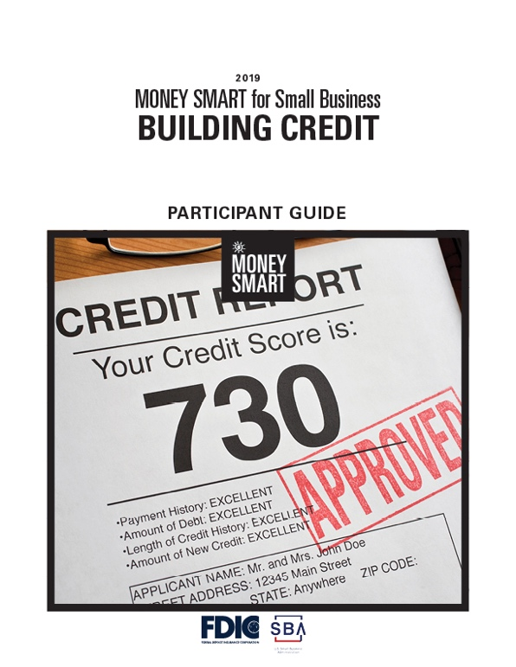
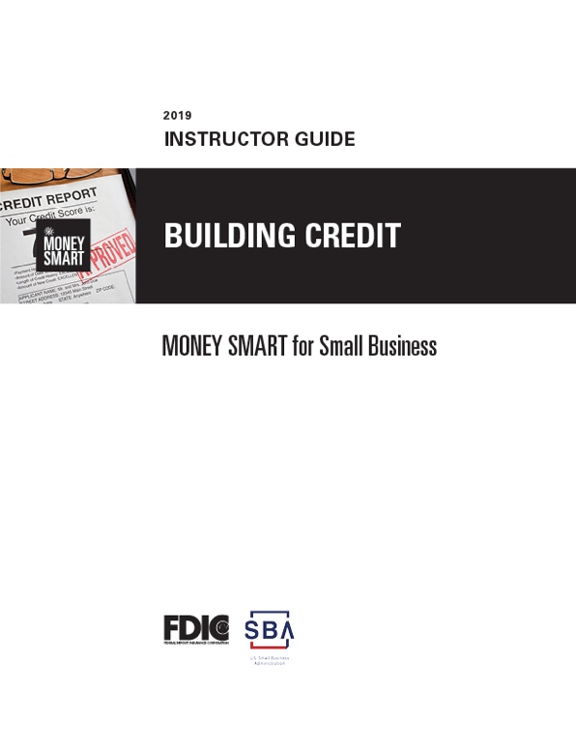
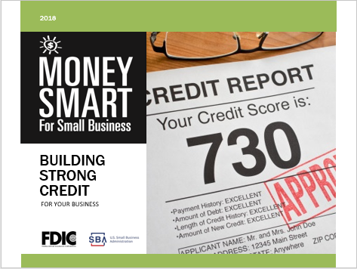
Standard Money Smart Curriculum Components
Participant Guide Instructor Guide PowerPoint Slides

Slide 16
Best Practices when Teaching MSSB
1. Know your audience!
Startup vs. seasoned business
2. Poll “intended” audience.
Efficient use of time
What does audience want to understand? (cash flow, business credit or banking services)

Slide 17
Best Practices when Teaching MSSB
3. Seek to educate.
Clarify misconceptions
Personal credit is business credit
Lines of Credit (LOC) are designed to fund cash flow gaps
Who needs a line? (Cash vs Accrual)
How to size a line request? (Typically 30-days of funding)
4. Find a partner by recruiting experts.
Bankers/Lenders
Insurance Brokers
Attorneys
Small Business Development Staff
5. Visit your training site.
TVs, monitors, projectors, etc.
“Plan B”

Slide 18
MSSB Preferred Topics
Bankers Teach:
Banking Services, Credit, Financial Management and Cash Flow modules
Accountants/ CPAs Teach:
Tax Planning and Reporting & Record Keeping
Insurance Brokers Teach:
Insurance, Organizational Types & Risk Management

Slide 19
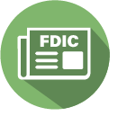
Stay Connected
Participate in MSSB Town Halls and other Money Smart events
Quarterly Money Smart News
Connect with:
Money Smart Alliance Members near you or in the same national program (SBDC, WBC)
FDIC Community Affairs Staff

Slide 20
All questions or comments please direct to: David Ramos at 202-898-6950 or daramos@fdic.gov

Slide 21
Q & A
Klassi Duncan
&
David Ramos

Slide 22
EMAIL US!
INFO@NWBC.GOV
#WebinarWednesday
TWITTER
@NWBC
FACEBOOK
@NWBCgov
Contact
NWBC
LINKEDIN
National Women's Business Council

