Slide 1
NWBC PUBLIC MEETING
June 9, 2020
#NWBC

Slide 2
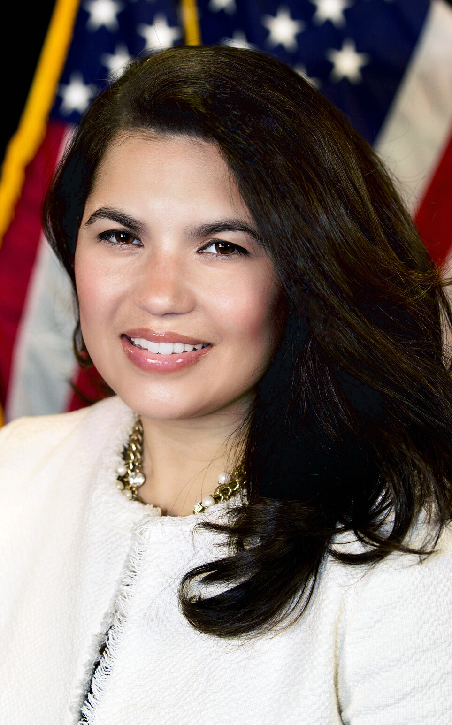
OPENING REMARKS
NWBC Executive Director
Nina Roque

Slide 3
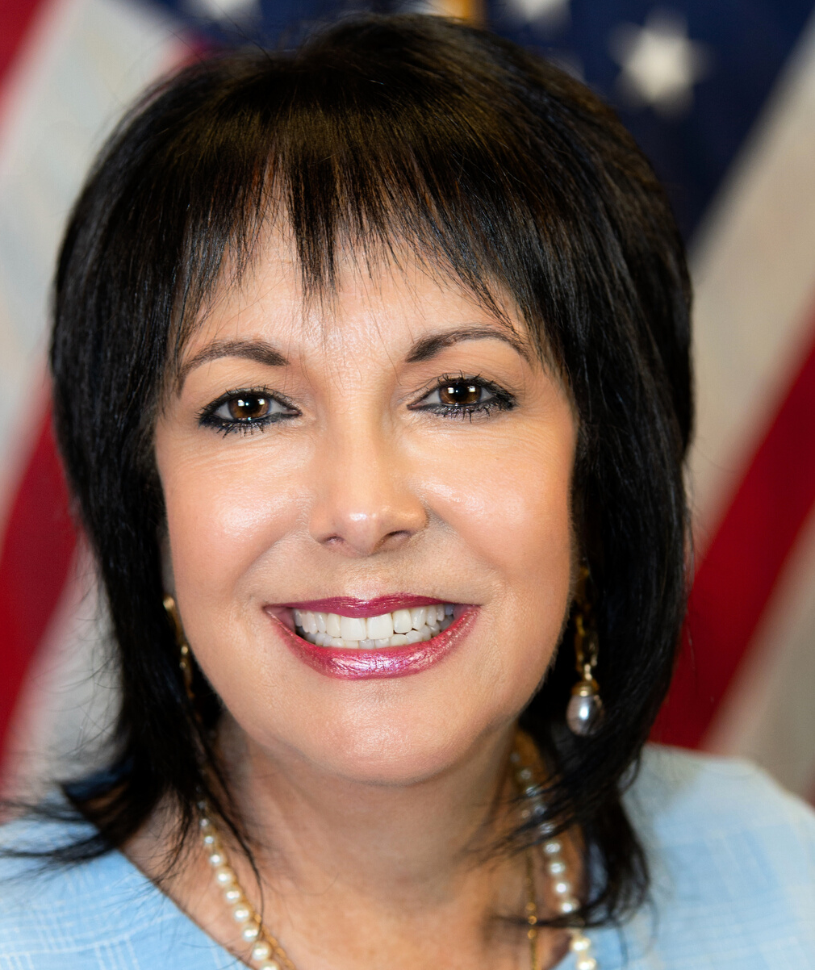
NWBC CHAIR
LIZ SARA

Slide 4
FY20 Policy Priorities
Access to Capital & Opportunity
Rural Women's Entrepreneurship
Women in
S.T.E.M
Click HERE to View Document

Slide 5
2018 ANNUAL BUSINESS SURVEY
(ABS)
#NWBC
Estimates show that in 2017 1.1 million employer firms were owned by women.
The sectors with the most women-owned businesses included the
health care and social assistance industry with 16.9 (192,159),
professional, scientific, and technical services with 16.4% (185,649),
and the retail trade industry with 11.7% (132,894).

Slide 6
ACCESS TO CAPITAL
& OPPORTUNITY
PAM PRINCE-EASON
VANESSA DAWSON
Co-Chair, Access to Capital & Opportunity Subcommittee
Co-Chair, Access to Capital & Opportunity Subcommittee

Slide 7
Nicole Cober
Maria Rios

Slide 8
RURAL WOMEN'S ENTREPRENEURSHIP
JESSICA FLYNN
Chair, Rural Women's Entrepreneurship Subcommittee

Slide 9
Barbara
Kniff-McCulla
Bonnie
Nawara
Rebecca
Hamilton

Slide 10
WOMEN IN STEM
MONICA STYNCHULA
Chair, Women In STEM Subcommittee

Slide 11
Marsha Firestone
Sandra
Robert
Susan Duffy

Slide 12
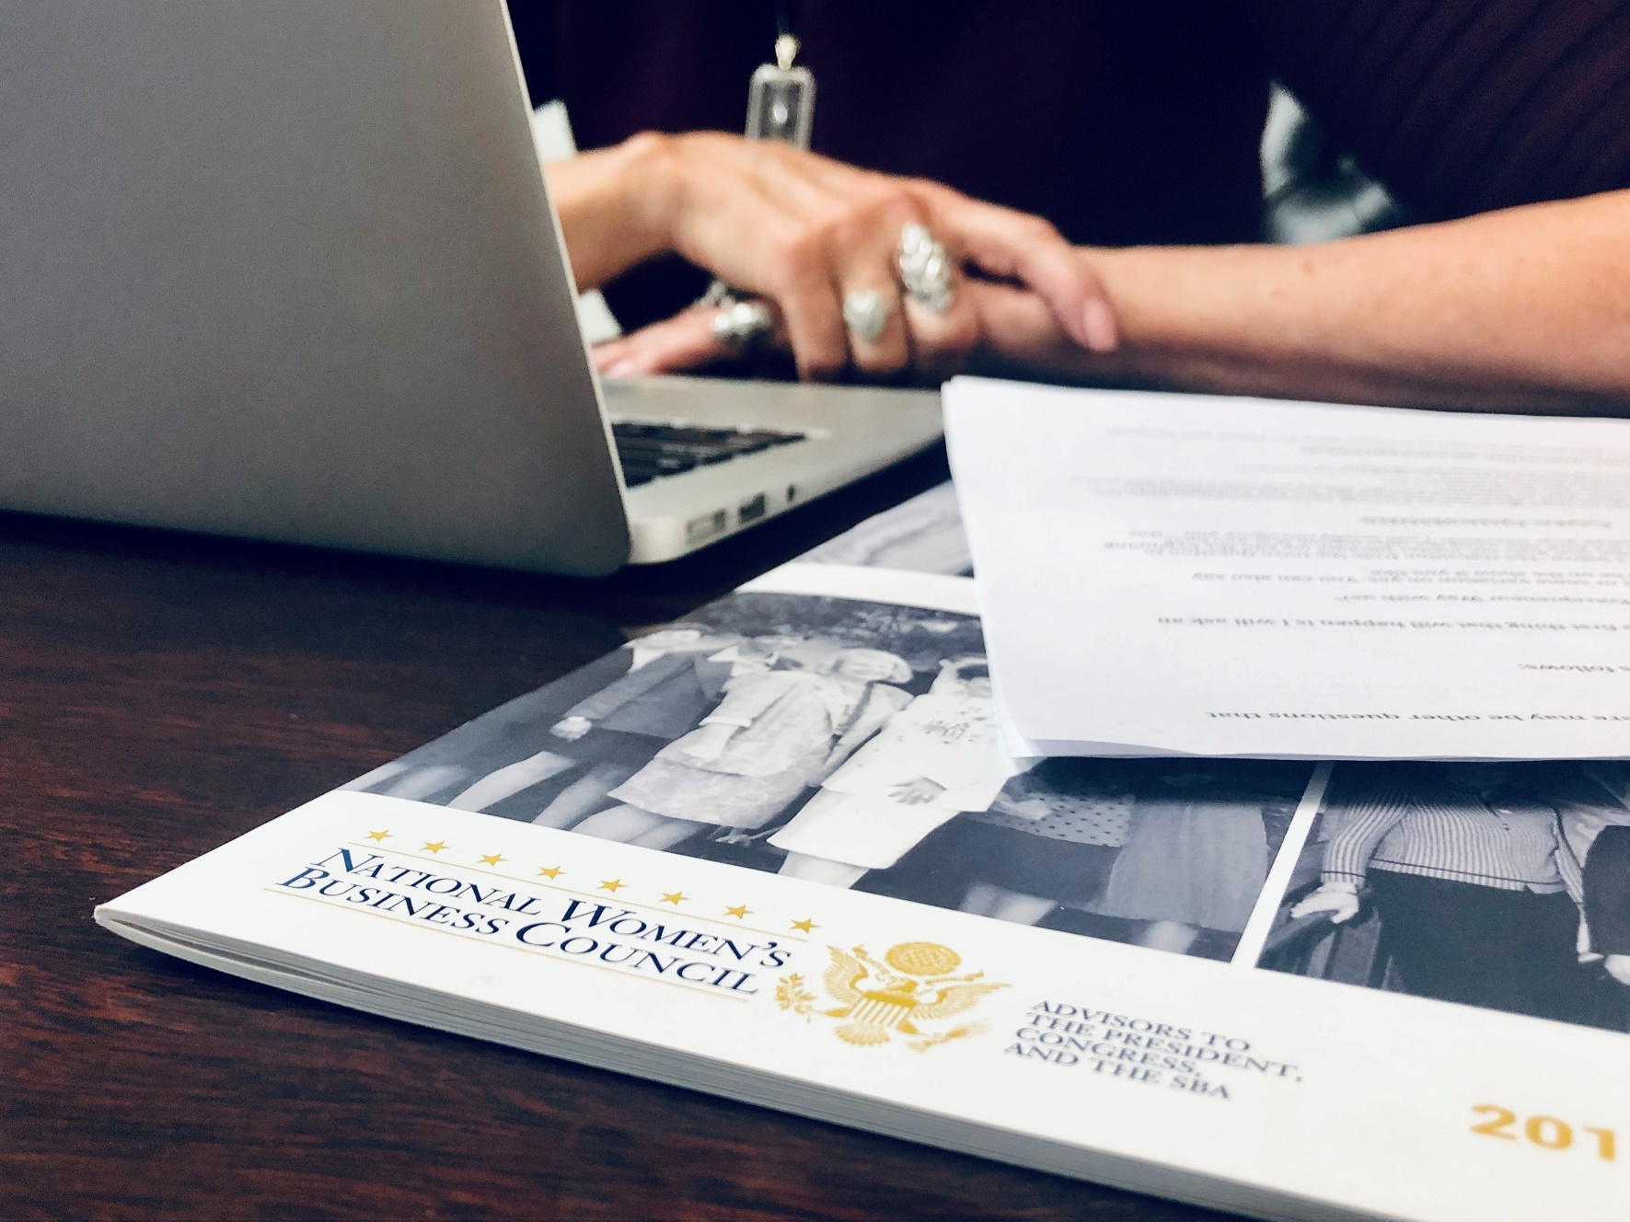
WOMEN IN STEM
Study on ‘Women’s Participation in the SBIR/STTR’
SBIR, Phase I proposals submitted to the 11 participating agencies between 2013 and 2018
Out of a total of 111,387 that were submitted, only 16,933 were submitted by WOSBs. That translates to 15.2%.
STTR, Phase I proposals submitted between those same years:
A total of 16,258 were submitted, with 2,137 of those being submitted by WOSBs—essentially 13.14% of the total number of proposals submitted.
Release Date: Expected July 2020

Slide 13
COMMUNICATIONS
NICOLE COBER
Chair, Communications Subcommittee

Slide 14
Shelonda Stokes
Marygrace Sexton

Slide 15
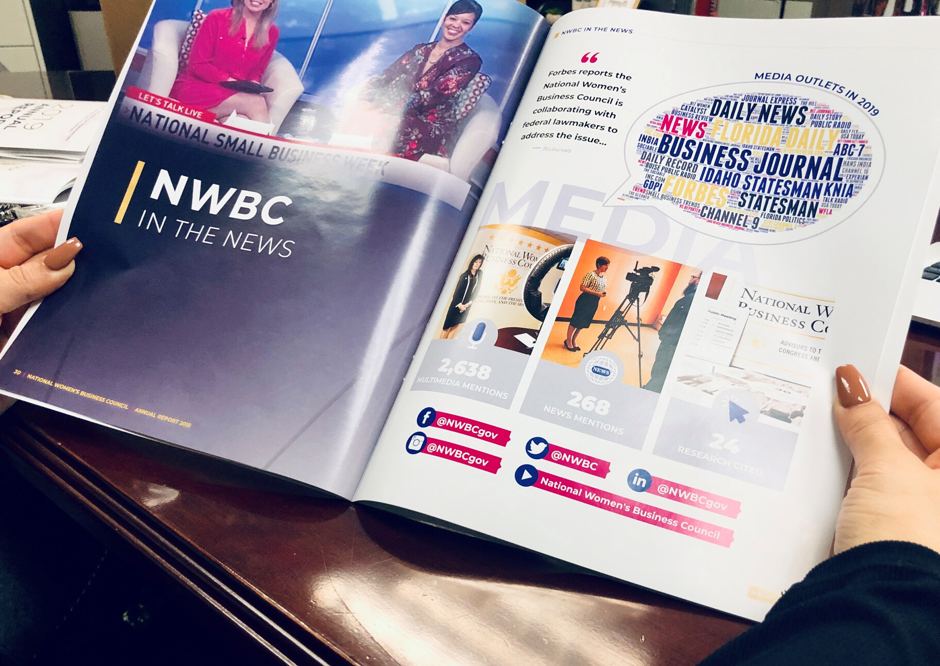
#NWBC

Slide 16
PUBLIC
STATEMENTS

Slide 17
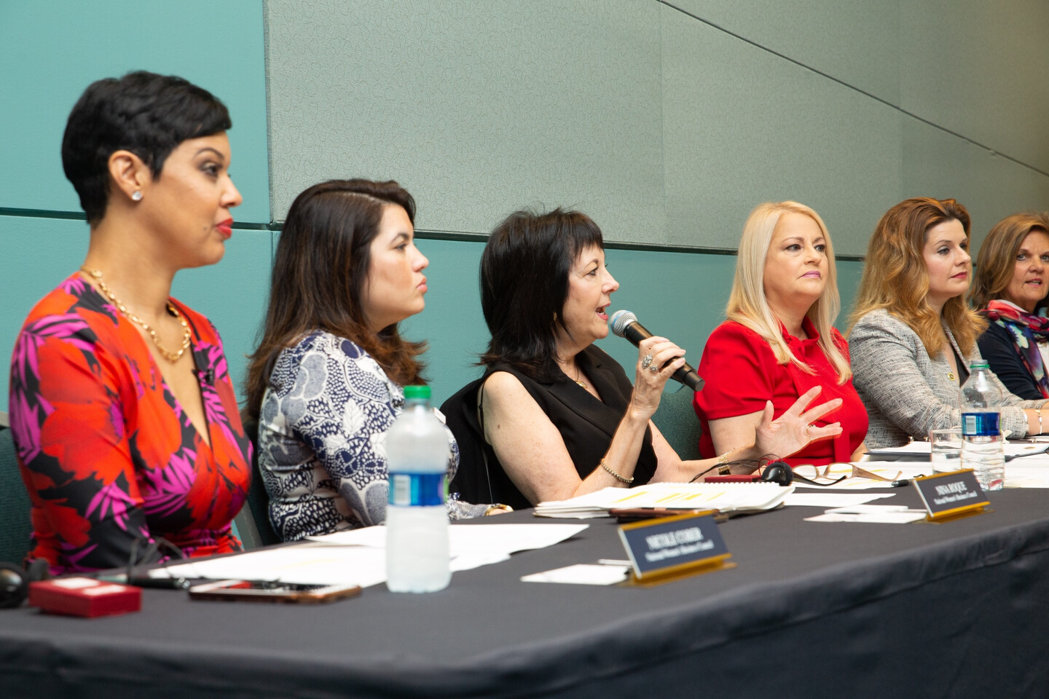
THANK YOU
FOR JOINING
US!
#NWBC
Twitter: @NWBC | Facebook: @NWBCgov | LinkedIn: National Women's Business Council

