Slide 2
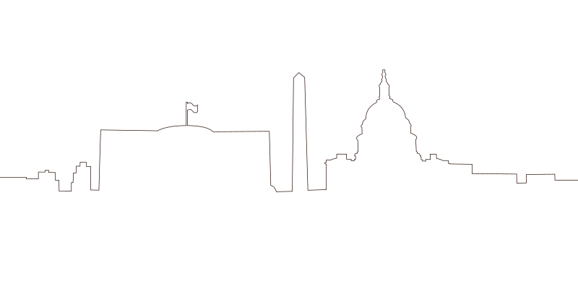
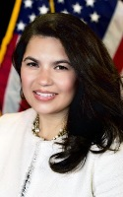
Opening Remarks
Nina Roque
Executive Director, National Women’s Business Council

Slide 3
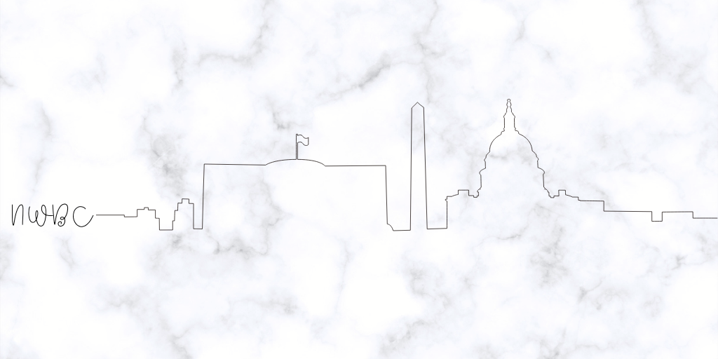
Therese Meers Counsel, Senate Committee on Small Business & Entrepreneurship

Slide 4
United States Census Bureau
Aneta Erdie
Assistant Division Chief, Governments and Business Owners Programs, Economic Reimbursable Surveys Division

Slide 6
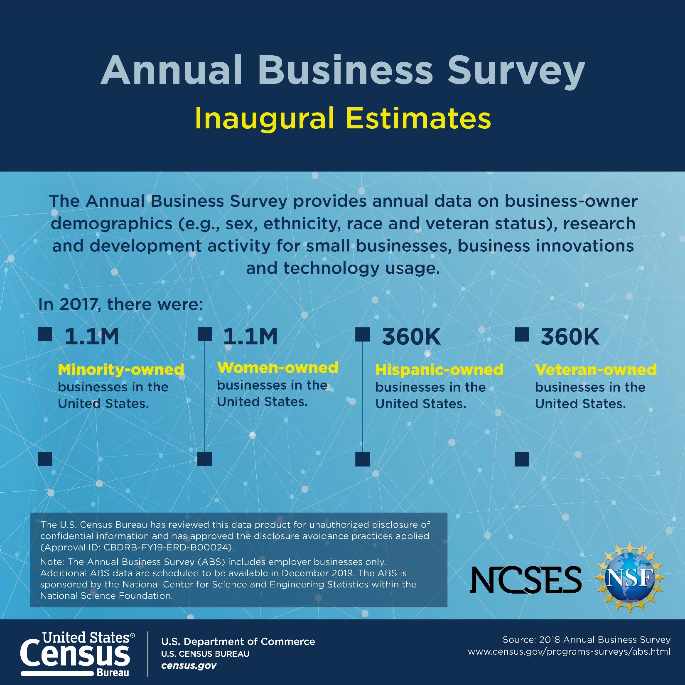

Slide 7
New Data Alert
2018 ABS - 1.1m women-owned employer businesses in 2017
2012 SBO – 1.0m women-owned employer businesses in 2012
2007 SBO – 910k women-owned employer businesses in 2007

Slide 8
Total Business Ownership
Quinquennial
Employers + Nonemployers
SBO employers
Annual Business Survey (ABS)
Only employers
Nonemployer Statistics by Demographics
(NES-D)
SBO nonemployers

Slide 9
ABS vs. SBO
ABS | SBO
Sponsored by NCSES | Appropriated by Congress
Annual | Quinquennial
Conducted on a firm (enterprise) basis | Conducted on a firm (enterprise) basis
Employer businesses included (excludes nonemployer businesses) | Employer and nonemployer businesses included
850,000 employer businesses | 1.75 million employer and nonemployer businesses
Owner demographics, R&D, Business characteristics, Owner characteristics, new topics each year (i.e. Innovation and Technology) | Owner demographics Business characteristics Owner characteristics

Slide 10
Annual Business Survey
Sponsored by the National Center for Science and Engineering Statistics (NCSES) within the National Science Foundation (NSF)
Annual collection for survey years 2017 - 2021
Mandatory under Title 13
Replaces content from other surveys
Survey of Business Owners (SBO)
Annual Survey of Entrepreneurs (ASE)
Business R&D and Innovation Survey for Microbusinesses (BRDI-M)
Innovation part of the Business R&D and Innovation Survey (BRDIS)

Slide 11
ABS Content
Collaboratively developed with NCSES
Core content maintained each survey year
Owner demographics
Research & Development (for small employer businesses)
Business Characteristics
Introduces a new business topic each survey year
Innovation Activities
Technology
Uses administrative data (i.e. industry classification and payroll)

Slide 12
Upcoming ABS Data Releases
Additional releases on a flow starting in December 2019 through July 2020
Detailed demographic and economic data
2-6 digit NAICS
US, state, msa, county, and economic place
Sex, ethnicity, race, veteran status
Years in business
Size of business
Business Characteristics
Innovation
Technology

Slide 13
Nonemployer Demographic Data
Nonemployer businesses not collected from ABS
Data available from administrative records
Use individual-level administrative and Census records to assign demographic characteristics to universe of nonemployer firms
Results in production of nonemployer business statistics by sex, race, Hispanic origin, veteran status, age, foreign-born status
Annual vs. quinquennial
Reduces respondent burden
Reduces cost
Increases quality
Aims to reduce dissemination lag in the future

Slide 14
Nonemployer Milestones
First methodology report with initial model - January 2019
Updated methodology report with additional reference years, geography, and NAICS – December 2019
Prototype of estimates of 2017 nonemployer business statistics by demographics – December 2020
Historically released 3 years after reference period as part of SBO
Additional characteristics beyond demographics (e.g., participation in wage sector, contract work, marital status) in future years

Slide 15
SBO employers
Annual Business Survey (ABS)
Only employers
Nonemployer Statistics by Demographics
(NES-D)
SBO nonemployers
Total Business Ownership
Annual
Employers + Nonemployers

Slide 16
Next Steps for Total Business Demographics
Release as two components for 2017 reference year
Employer business demographics
Nonemployer business demographics
Combine into single business demographic data product
Next couple of years

Slide 17
Contact Information
Aneta Erdie, Assistant Division Chief, Governments & Business Owners Programs – aneta.erdie@census.gov
Patrice Hall, Branch Chief, Business Owners Branch – patrice.n.hall@census.gov
Business Owners Branch – adep.annual.business.survey@census.gov

Slide 18
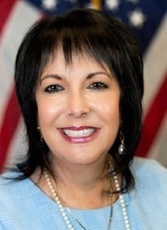
Council Vision
Liz Sara
Chair, National Women’s Business Council

Slide 19
Policy Recommendations

Slide 20
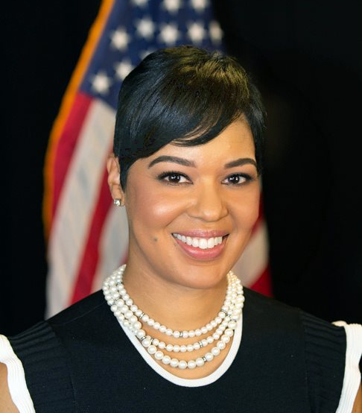
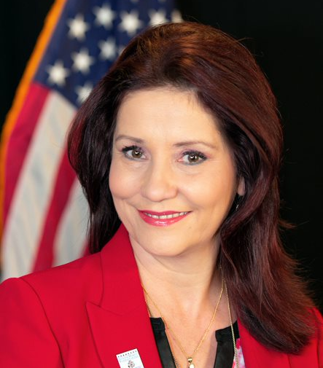
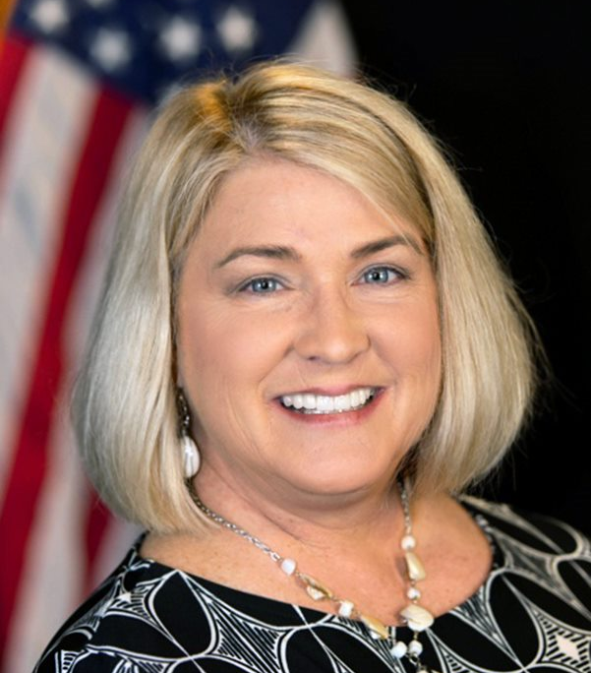
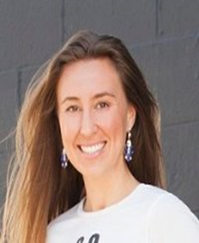
Access to Capital & Opportunity
Subcommittee Chair
Rebecca Contreras
Subcommittee Members
Nicole Cober
Pamela Prince-Eason
Vanessa Dawson

Slide 21
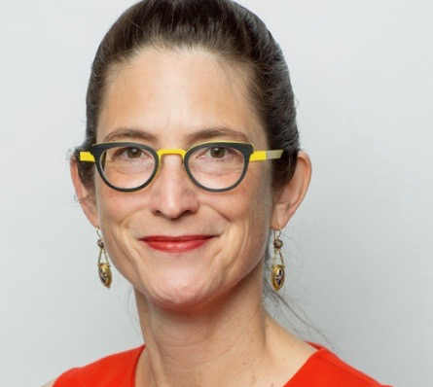
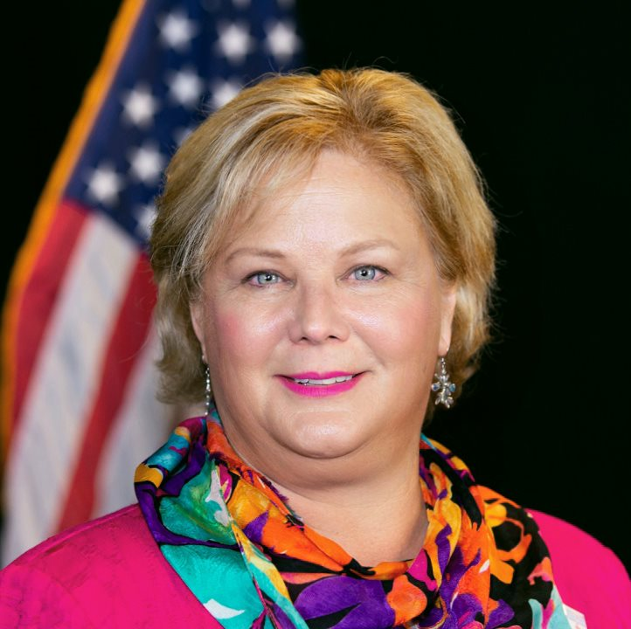
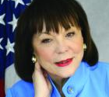
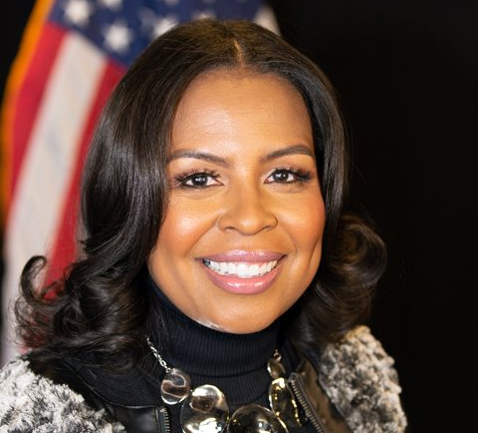
Women in STEM
Subcommittee Chair
Monica Stynchula
Subcommittee Members
Sandy Robert
Marsha Firestone
Shelonda Stokes

Slide 22
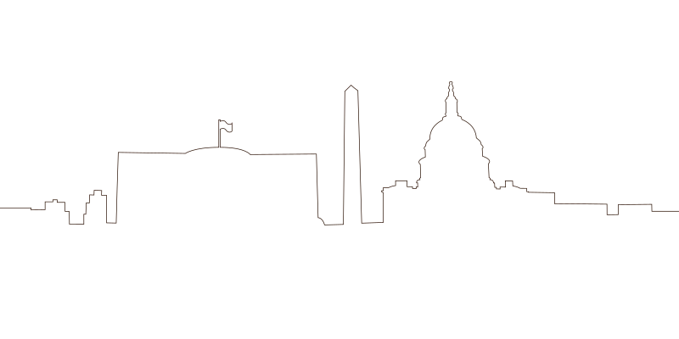
Rural Entrepreneurship
Subcommittee Chair
Marygrace Sexton
Subcommittee Members
Jessica Flynn
Rebecca Hamilton
Bonnie Nawara
Barbara Kniff-McCulla

Slide 23
Public Comment & Questions

Slide 24
Thank You

